Slide 1



Session 1: Introduction to
Data structures

Slide 2


Powerful resources
GeeksforGeeks Data structures section: https://www.geeksforgeeks.org/data-structures/?ref=shm
Visualization tool for Data structures: https://www.cs.usfca.edu/~galles/visualization/Algorithms.html
What are Data structures? From the perspective of a software developer at google: https://www.youtube.com/watch?v=bum_19loj9A
CS50 Data Structures: https://www.youtube.com/watch?v=2T-A_GFuoTo&t=80s

Slide 3
How important is Data structures?
Data structures is very important for anyone considering a career involved with software development. Data structures is an essential tool for building applications in an efficient manner. Have you ever opened an application and felt like it was taking too much time to load the data? It might be because they are using a wrong data structures. An example would be GTA loading screen. A hacker made it load 25% faster by using the right Data structure. Also, Knowledge of Data structures and algorithms is also essential for passing software engineering roles in big companies. Such as Google, Facebook, etc.
Hacker reduces GTA Online load times by roughly 70 percent: https://arstechnica.com/gaming/2021/03/hacker-reduces-gta-online-load-times-by-over-70-percent/

Slide 4
Recap on Arrays
An array is a collection of items stored at contiguous memory locations. The idea is to store multiple items of the same type together.
Static vs Dynamic Arrays:
Static Arrays: int arr[10] -> can`t be resized
Dynamic Arrays: int* arr = new int[10] -> can be resized, later we can say that arr = new int[20]
https://stackoverflow.com/questions/2672085/static-array-vs-dynamic-array-in-c

Slide 5
Expanding Arrays
 |  |  |  | 1 | 2 | 3 | ‘h’
‘e’ | ‘l’ | ‘l’ | ‘o’ | /0
Notice how they were inserted in a different place in memory. We must copy the content and place it somewhere else which can be costly.
 |  |  |  |  |  |  | ‘h’
‘e’ | ‘l’ | ‘l’ | ‘o’ | /0 | 1 | 2 | 3
4 | 5

Slide 6
Advantages of Arrays
Arrays represent multiple data items of the same type using a single name.
In arrays, the elements can be accessed randomly by using the index number.
Can be the base of many data structures.
Disadvantages of Arrays
The number of elements to be stored in an array should be known in advance.
Insertion and deletion are quite difficult in an array as the elements are stored in consecutive memory locations and the shifting operation is costly.

Slide 7
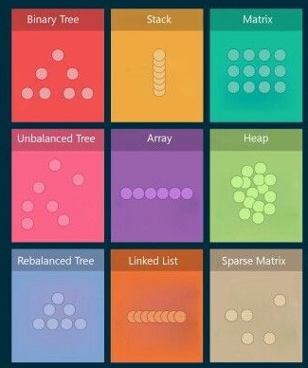
What does Data structures mean?
A data structure is a particular way of organizing data in a computer so that it can be used effectively. It is a collection of data objects that allow storing retrieval and organizing data on systems.

Slide 8
The magic of Data structures
Data structures can improve your programming life! Think of Data structures as tools that can make your program a lot faster or a lot simpler for yielding the same result. Knowing how to use these tools is super beneficial and will result in very noticeable changes.
Let’s take a closer look on what data structures can do with code!

Slide 9
Problem
Let`s say we have many Emails and passwords of users and given a random user email. We should output the password corresponding.
Email | Password
firstemail@gmail.com | password1
Secondemail@gmail.com | password2
etc@gmail.com | passwordetc
Random Email: Secondemail@gmail.com
Output: password2

Slide 10
Array solution
We can solve this problem by using an array and iterating over each element to search for the email. When we come across the email. Then output the Password:
arr[SIZE][2] -> SIZE represents the number of users, and ‘2’ for the email and password
for (int i = 0; i < SIZE; i++)
{
if (arr[i][0]== randomEmail)
return arr[i][1];
}
But this solution is very slow as the size grows and not concise.

Slide 11
Map solution
Map is a data structure that consists of a Key and value.
Intialize map:
map<string,string> x; //first string is the key and the second is the val
Add to map:
x[email] = password; //map the key with value
Get from map:
cout << x[email]; //printing the value of a key

Slide 12
Map solution
Using a map this problem can become a piece of cake! All you need is:
return mp[randomEmail];
And that`s the magic of data structures. Changing the data structure resulted in a code that is a lot simpler and that can be drastically faster. But yielding the same output!

Slide 13
The means of comparing Data structures
1-The time it takes: You should ask yourself which data structures will achieve your output faster.
2-It`s usability: You should ask yourself which data structures is going to make your code more concise.
3-The space it takes: You should ask yourself which data structures is going to make your code take less space.
There is often a tradeoff between time and space.

Slide 14
Time complexity
Measuring the time complexity of an algorithm is very important to compare different approaches and try to produce the optimal solution. But a problem arises when we try to measure Time complexity based on the actual time it takes and the problem is as follows:
you will get different timings on the different machine. So, we can say that actual time requires to execute code is machine dependent (whether you are using pentium1 or pentium5) and also it considers network load if your machine is in LAN/WAN. Even you will not get the same timings on the same machine for the same code, the reason behind that the current network load.
More here: https://www.geeksforgeeks.org/understanding-time-complexity-simple-examples/

Slide 15
Time complexity
Instead of measuring actual time required in executing each statement in the code, we consider how many times each statement execute.
Int sum = 0; --->> 1 time
for (int i = 0; i < N; i++) --->> 3N times
{
sum+=arr[i] --->> 2N times
}
The above code has (1+ 3N+ 2N) instructions

Slide 16
Big O notation
In plain words, Big O notation describes the complexity of your code using algebraic terms. We use it in order to present Time and Space complexity in terms of input. In other words, Big-O notation is a way to track how quickly the runtime grows relative to the size of the input. It’s important to use it in order to understand how your algorithm scales. Rather than only understanding how it preforms with a single input.

Slide 17
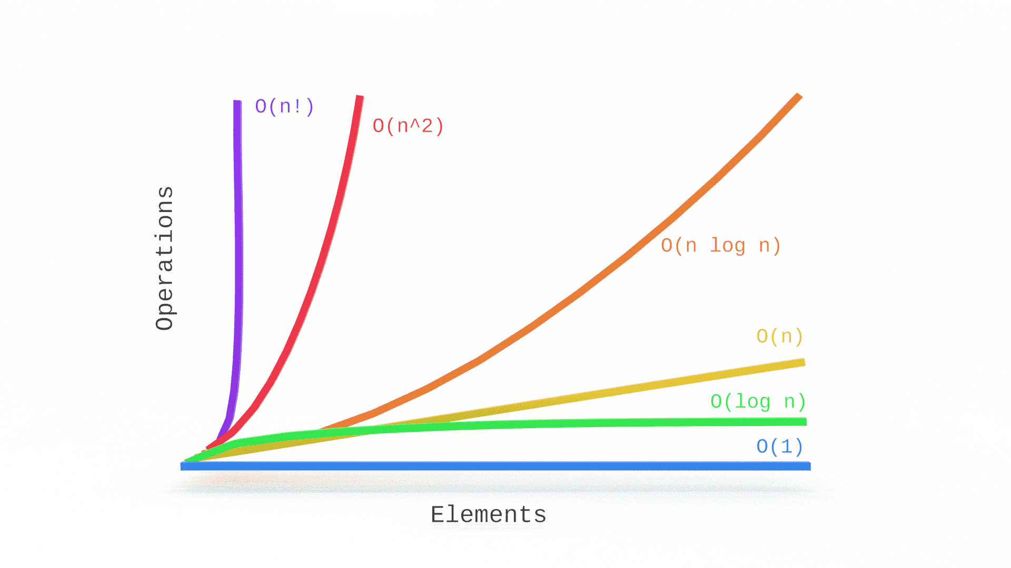
Big O notation
From the previous case we found that the piece of code has (1+ 3N+ 2N) instructions. But always calculating each instruction is not feasible and complex. What we should do instead is:
1- Find the fastest growing term
2- Take out the coefficient/constants
So, in this case the faster growing term is 3N. Takeout the coefficient and we are left with a running time if O(N)
The purpose of the Big-O notation is to find what is the dominant factor as the value tends towards the infinity.
Constants are moved to 0(1), so O(1000)=O(1)
Big O in depth: https://www.youtube.com/watch?v=D6xkbGLQesk&t=704s

Slide 18
Some examples:
2. O(n) or linear time
void printAllElementOfArray(int arr[], int size) {
for (int i = 0; i < size; i++) {
printf("%d\n", arr[i]);
}
}
O(1) or Constant time
void printFirstElementOfArray(int arr[]) {
printf("First element of array = %d",arr[0]);
}
3. O(n²) or quadratic time
void printAllPossibleOrderedPairs(int arr[], int size) {
for (int i = 0; i < size; i++) {
for (int j = 0; j < size; j++) {
printf("%d = %d\n", arr[i], arr[j]);
}
}
}
3. O(log(n))
bool binarysearch(int arr[], int size,int target) {
int start =0,end=size-1,mid;
while(start<end){
int mid = (start + end)/2;
if(arr[mid]== target)
return target;
…….
…….
}
}

Slide 19
Linear vs binary search
O(Log(N))
O(N)

Slide 20
Best vs Average vs worst case
Best case = fastest time to complete. For example, the best case for linear search would be if the element is the first element in the array -> O(1)
Worst case = slowest time to complete. For example, the worst case for a linear search algorithm is for the element to be the last element in the array. (Most used)
Average case = arithmetic mean. Run the algorithm many times, using many different inputs of size n that come from some distribution that generates these inputs (in the simplest case, all the possible inputs are equally likely), compute the total running time (by adding the individual times), and divide by the number of trials. You may also need to normalize the results based on the size of the input sets.
More here: https://stackoverflow.com/questions/9561242/best-worst-and-average-case-running-times

Slide 21
Importance of log (Base 2)
Log(x) = y if and only if 2^y = x.
meaning that log(8)=3, log(1024)=10 because 2^10=1024
Let’s say an algorithm runs in O(n) where n is equal to 4,000,000,000. Imagine each input takes 1 nanosecond. So the algorithms might take 4,000,000,000 nanoseconds. Which is equal to 4 days!
Try to guess without calc: What is the log2(4,000,000,000)?
The answer is 32! Which means that if the O(n) algorithms takes 4 days, the O(log(n))
takes only 32 nanoseconds.
You can find more here: https://www.youtube.com/watch?v=ho1eFp1nDEo

Slide 22
Problem
Given an integer N followed by an array of N-1 integers with size N, then integer num and integer k. Insert num at position k.(Zero-based)
Sample:
N = 5, arr = [10,20,40,50,_], num= 30 , K = 2
Output: [10,20,30,40,50]

Slide 23

Our slogan in OSC is: “Don't Reinvent the wheel”. Meaning that you don’t have to start from point zero and do everything from scratch. A lot of data structures are mainly used to support this idea. As we saw in the previous example. We had to write some code in order to simply insert an element to the array. That goes against our slogan!

Slide 24
Array List or Vectors
In short, vector or Array lists are dynamic arrays with functionalities that are ready to use. Instead of having to implement everything from scratch. You can use Array lists, that will help you to write more concise and straightforward code, without having to worry about forgetting something and debugging. Let`s say you want to delete and element from an array. Instead of having to implement that you just simply call the delete function used.
In c++, You simply add
#include <vector>
And then use the intialize as follows:
vector <int> vec = {1,2,3,4};
Here you can see the different things vectors can do: https://www.geeksforgeeks.org/advantages-of-vector-over-array-in-c/

Slide 25
Vectors functions
push_back() – It push the elements into a vector from the back
pop_back() – It is used to pop or remove elements from a vector from the back.
insert() – It inserts new elements before the element at the specified position
erase() – It is used to remove elements from a container from the specified position or range.
swap() – It is used to swap the contents of one vector with another vector of same type. Sizes may differ.
clear() – It is used to remove all the elements of the vector container
size() – Returns the number of elements in the vector.
max_size() – Returns the maximum number of elements that the vector can hold.
capacity() – Returns the size of the storage space currently allocated to the vector expressed as number of elements.
resize(n) – Resizes the container so that it contains ‘n’ elements.
Here you can see the different things vectors can do: https://www.geeksforgeeks.org/vector-in-cpp-stl/

Slide 26
Spot the difference
Vector<int> vec;
for(int i=0; i<n;i++)
{
int x;
cin >> x;
vec.push_back(x);
}
Vector<int> vec(n);
for(int i=0; i<n;i++)
{
cin >> vec[i];
}
Here you set an initial size that you know you are not going to go beyond. Which in turn avoids unnecessary expansions.
When you don’t initialize a vector with a size. It assumes a size. So when you push_back more than the initialized size. It expands which is costly.

Slide 27
The end
This session mainly was made to showcase the importance and usefulness of data structures. As studying something which you may not know how is it useful is illogical and demotivating.
A very important link where you can find complexities of each operation for data structures: https://www.bigocheatsheet.com/

